Slide 1
Standards and Regulations
Team G
Mentor: Oliver Kroemer
Aditya Gaddipatti | Pallavi Madhukar | Vaidehi Patil | Bruce Kim | Steven Brills

Slide 2

The Team

Slide 3
Standards Covered
ANSI/RIA R15.08-1-2020
Industrial Mobile Robots - Safety Requirements - Part 1: Requirements For The Industrial Mobile Robot
IEEE 12207-2008
Systems and software engineering - Software life cycle processes

Slide 4
ANSI/RIA R15.08-1-2020
Industrial Mobile Robots - Safety Requirements - Part 1: Requirements For The Industrial Mobile Robot

Slide 5
What does the standard contain?
ANSI/RIA R15.08-1-2020 Industrial Mobile Robots - Safety Requirements - Part 1: Requirements For The Industrial Mobile Robot
The standard DOES NOT prescribe hard performance requirements on the design
INSTEAD
The aim of this standard is to:
Standardized language used to describe AMRs and AMR features
Recommend the methods to be used when arriving at design requirements
Provide a comprehensive approach to quantify the impact and likelihood of AMR hazards
Point to other relevant standards that can inform detailed design choices and compliance
Specify the verification and validation approaches that may be used to evaluate compliance

Slide 6
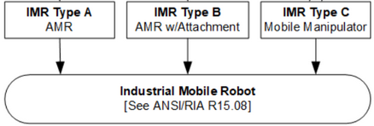
What does it apply to and why?
ANSI/RIA R15.08-1-2020 Industrial Mobile Robots - Safety Requirements - Part 1: Requirements For The Industrial Mobile Robot
“Industrial” as used in the standard is quite broad in scope and covers multiple areas that include both production and service environments where mobile robots interact with people. (Excludes household, consumer, space, sea and military robots)
Excludes rail-mounted robots.
Categorises autonomous mobile robots into:
Building common vocabulary: Some interesting definitions and distinctions
AGV vs AMR
Collision Avoidance - Prevents or reduces severity of unavoidable collision
Docking - Connecting with another object
Fleet manager
AMR operations modes (Manual, Automatic, Semi-automatic and Diagnostic)
Restricted Areas
Notes:
AMR includes obstacle avoidance and trajectory planning, AGV uses pre-defined guidepath

Slide 7
What are its main prescriptions?
ANSI/RIA R15.08-1-2020 Industrial Mobile Robots - Safety Requirements - Part 1: Requirements For The Industrial Mobile Robot
Risk Reduction Measures
Design Measures
Control Measures
Informative Measures
Administrative Measures
Operation mode indicators
Single point portable control unit for manual control
Designed stopping distance and obstacle impact considerations as a function of current speed, load and other operating parameters.
Velocity limiters
Presence sensing devices and safety stops (ex. Safety lasers)
Emergency stop and restart functions
Best practices guides and user manuals
Limits of safe operation specifications
Warning signs and labels
Safety training
Standard Operating Procedures
Controls on energy sources
Supervised operation
Notes:
Example of cases where emergency stop is not required - Examples of cases in which an emergency stop might not lessen the risk include, but are not
limited to: If it would not reduce the stopping time; if it would not enable the special measures required to
deal with the risk to be taken.

Slide 8
What are its main prescriptions?
ANSI/RIA R15.08-1-2020 Industrial Mobile Robots - Safety Requirements - Part 1: Requirements For The Industrial Mobile Robot
Verification and Validation Approaches:
Visual Inspection
Practical Tests
Measurement
Observation during operation
Review of application-specific schematics, circuit diagrams and design materials
Review of task-based risk assessment
Review of specifications and information for use
Annex A - Fairly comprehensive list of potential hazards when working with AMRs
Annex B - Detailed disambiguation between AMR types
Annex C - Risk Quantification
Annex D - Verification and validation methods that apply to each of the prescriptions
Annex E - Keepout zone specifications
Annex F - Stability tests

Slide 9
How does it apply to the team's project?
ANSI/RIA R15.08-1-2020 Industrial Mobile Robots - Safety Requirements - Part 1: Requirements For The Industrial Mobile Robot
Some of the identified potential hazard scenarios include:
Intentional and unintentional human machine interaction situations
Ex: Collection of the tomatoes by a human picker from a main depot where the robot deposits the tomatoes.
Interaction with static objects
Ex: Manipulation of the tomato cluster in the farm
Unexpected power-up or power loss of the system or sub-systems
Ex: Failure of the wrist-accelerometer board (WACC) and incapacity for actuation
Reasonably foreseeable misuse of the AMR
Ex: Use of the manipulator for leaf pruning or other tasks not meant to be done
Behavior during failure of various sub-systems
Ex: Internal computer hanging due to heavy image processing

Slide 10
IEEE 12207-2008
Systems and software engineering - Software life cycle processes

Slide 11
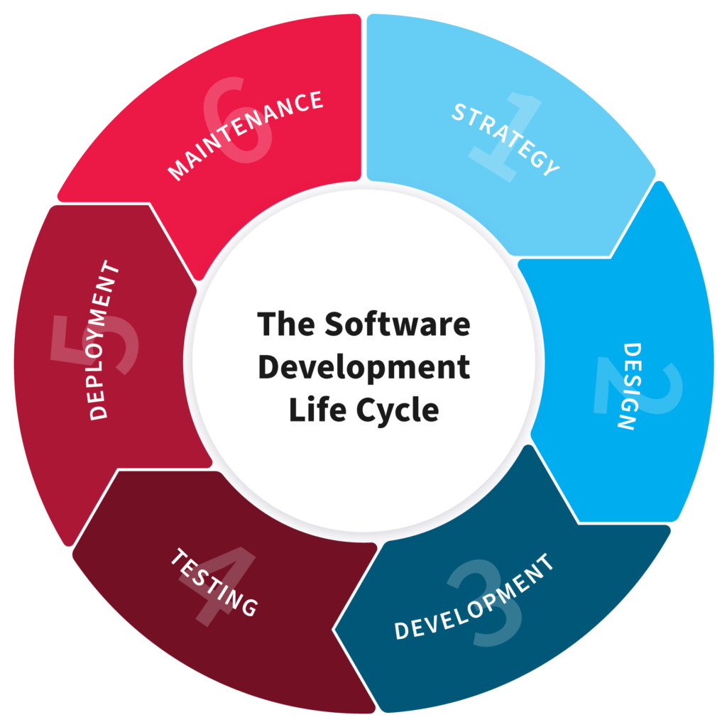
What is it about?
IEEE 12207-2008 Systems and software engineering -- Software life cycle processes
Primary standard that defines all the processes required for developing and maintaining software systems, including the outcomes and/or activities of each process.
Born in 1995
Provides framework for software life-cycle processes
How to define, control and improve life-cycle
How to acquire a system that
Contains software
Is a stand-alone software product
Is a software service
This document can be used in one or more of the following modes:
By an organization
By a project
By an acquirer and a supplier
By process assessors
Notes:
https://www.iso.org/obp/ui/#iso:std:iso-iec-ieee:12207:ed-1:v1:en
This document provides a common process framework for describing the life cycle of systems created by humans, adopting a Software Engineering approach. Software Engineering is an interdisciplinary approach and means to enable the realization of successful software systems. It focuses on defining stakeholder needs and required functionality early in the development cycle, documenting requirements, and performing design synthesis and system validation while considering the complete problem. It integrates all the disciplines and specialty groups into a team effort forming a structured development process that proceeds from concept to production to operation and maintenance. It considers both the business and the technical needs of all stakeholders with the goal of providing a quality product that meets the needs of users and other applicable stakeholders. This life cycle spans the conception of ideas through to the retirement of a system. It provides the processes for acquiring and supplying systems.

Slide 12

To which products/markets does it apply?
IEEE 12207-2008 Systems and software engineering -- Software life cycle processes
License/maintenance of software
Cloud based software.
Software Industry
Cloud computing, Web services, IoT
Communications, Data services
Game development
Software within systems
Robotics
Retail and E-commerce
Firmware

Slide 13
What are its main prescriptions?
IEEE 12207-2008 Systems and software engineering -- Software life cycle processes
Stages vs Processes
Stage: "period within the life cycle of an entity that relates to the state of its description or realization". A stage is typically a period of time and ends with a "primary decision gate".
Process: "set of interrelated or interacting activities that transforms inputs into outputs". The same process often recurs within different stages.- Delves more into processes
Software life cycle processes are divided into four main process groups:
Agreement
Organizational
Technical Management
Technical
Applied to primary activities of acquisition and supply ; configuration; and operation, maintenance, and disposal
Notes:
Stages (aka phases) are not the same as processes, and this standard only defines specific processes - it does not define any particular stages. Instead, the standard acknowledges that software life cycles vary, and may be divided into stages (also called phases) that represent major life cycle periods and give rise to primary decision gates. No particular set of stages is normative, but it does mention two examples:
The system life cycle stages from ISO/IEC TS 24748-1 could be used (concept, development, production, utilization, support, and retirement).
It also notes that a common set of stages for software is concept exploration, development, sustainment, and retirement.
The life cycle processes the standard defines are not aligned to any specific stage in a software life cycle. Indeed, the life cycle processes that involve planning, performance, and evaluation "should be considered for use at every stage". In practice, processes occur whenever they are needed within any stage.
Agreement processes[edit]
Here ISO/IEC/IEEE 12207:2017 includes the acquisition and supply processes,^{[1][2][16]} which are activities related to establishing an agreement between a supplier and acquirer. Acquisition covers all the activities involved in initiating a project. The acquisition phase can be divided into different activities and deliverables that are completed chronologically. During the supply phase a project management plan is developed. This plan contains information about the project such as different milestones that need to be reached.
Organizational project-enabling processes[edit]
Detailed here are life cycle model management, infrastructure management, portfolio management, human resource management, quality management, and knowledge management processes.^{[1][2][16]} These processes help a business or organization enable, control, and support the system life cycle and related projects. Life cycle model management helps ensure acquisition and supply efforts are supported, while infrastructure and portfolio management supports business and project-specific initiatives during the entire system life cycle. The rest ensure the necessary resources and quality controls are in place to support the business' project and system endeavors. If an organization does not have an appropriate set of organizational processes, a project executed by the organization may apply those processes directly to the project instead.^{[1]}
Technical management processes[edit]
ISO/IEC/IEEE 12207:2017 places eight different processes here:^{[1][2][16]}
[Project planning]
Project assessment and control
Decision management
Risk management
Configuration management
Information management
Measurement
Quality assurance
These processes deal with planning, assessment, and control of software and other projects during the life cycle, ensuring quality along the way.
Technical processes[edit]
The technical processes of ISO/IEC/IEEE 12207:2017 encompass 14 different processes,^{[1][2][16]} some of which came from the old software-specific processes that were phased out from the 2008 version.^{[2]}
The full list includes:^{[1][2][16]}
Business or mission analysis
Stakeholder needs and requirements definition
Systems/Software requirements definition
Architecture definition
Design definition
System analysis
Implementation
Integration
Verification
Transition
Validation
Operation
Maintenance
Disposal

Slide 14
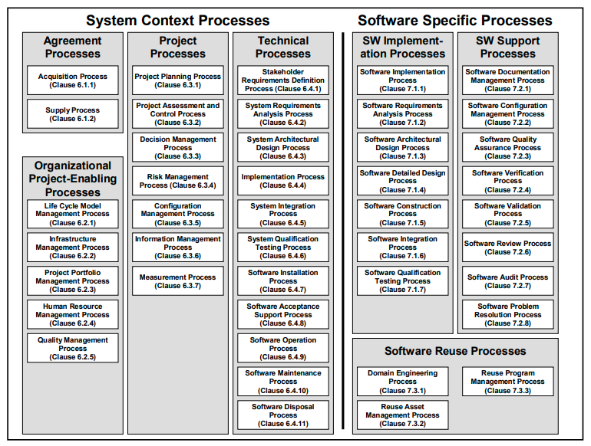
How does it apply to the team's project?
IEEE 12207-2008 Systems and software engineering -- Software life cycle processes
Software Requirement Analysis:
Functional/Performance requirements
cyberphysical architecture
software architecture
Development and maintenance:
Coding standard, version control
Implementation:
Subsystem unit level development
Build interface
Achieve required functions
Integration:
Integration between subsystems,
behavior planner
Integrated ROS architecture
Verification and Validation:
Testing and validation at unit subsystem
and system level
Notes:
Project Planning:
Estimation of effort, allocation of tasks, availability of infrastructure
Risk Management:
Risk identification, analysis, treatment, monitoring and management process evaluation
Development and maintenance:
Coding standard, version control
Software Requirement Analysis:
Functional and performance requirements, cyberphysical architecture, software architectural design, coding and testing, and integration
Verification and Validation:
Testing and validation at unit, subsystem and system level
Software implementation
Produce a specified system element.
Our case: writing correct and safe code, building interfacing, achieving required functions.
Software integration:
To combine the software units and software components, producing integrated software items.
Our case: units (IMU reading, state estimator, planner, and controller) -> integrated ROS architecture.

Slide 15

Questions
YOUR SAFETY IS OUR CONCERN

